Slide 1
Weekly Meeting
CCI
13 Aug 2024

Slide 2
Progress Summary
Surface Energies not as expected
Workflow and function for adsorbate's
Discussion of next steps
- I have added a function that adds a Cl atom
- Allows for manipulation of Cartesian coordinates
- Plateau doesn’t seem to be happening with ST
- I have tried one avenue, I have some more things to attempt
- Not sure what to do if surface energies don’t plateau, with time pushing on want to find a solution quickly

Slide 3
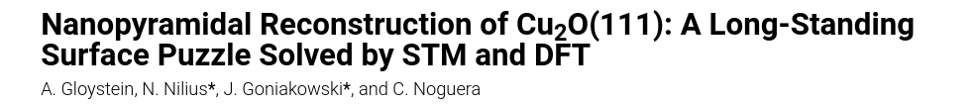
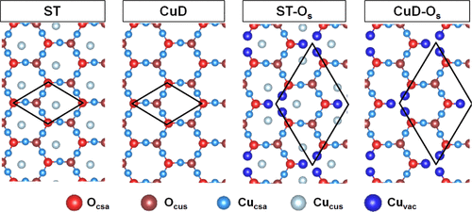
DFT with 111 Surfaces - ST

Slide 4
DFT with 111 Surfaces - ST
Nlayers | Eslab qn | Esurf | E difference
3 | -555967.192 | 0.0408 | 0.00623
4 | -741290.786 | 0.0346 | 0.00258
5 | -926614.160 | 0.0320 | 0.00353
6 | -1111937.591 | 0.0285 | 0.00291
7 | -1297260.985 | 0.0256 | 0.00309
8 | -1482584.389 | 0.0225 | 0.0225

Slide 5

DFT with 111 Surfaces - ST
Nlayers | Eslab (single point) | Eslab (final inter) | Esurf | E difference
3 | -555966.763 | -555967.314 | 0.0388 | 0.00420
4 | -741290.00232 | -741290.786 | 0.0346 | 0.00258
5 | -926613.239 | -926614.160 | 0.0320 | 0.00325
6 | -1111936.475 | -1111937.573 | 0.0287 | 0.00322
7 | -1297259.711 | -1297260.986 | 0.0255 | 0.0255

Slide 6
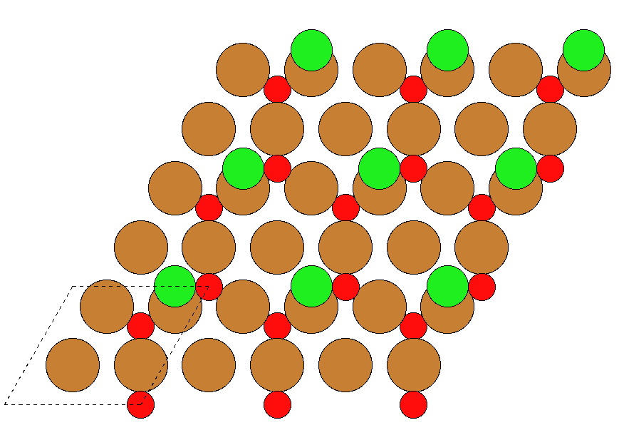

DFT with 111 Surfaces – ST with Chlorine

